Slide 1
Getting started—the journey begins Transition Assistance Overview

Slide 2
Agenda
What is Transition Assistance?
Coaching
Resources
FAQs
Roadmap to career transition—getting started
Step 1: The journey begins
Step 2: Where do you want to go?
Next steps

Slide 3
What is Transition Assistance?
Transition Assistance (TA) provides guidance and coaching to help you identify, select and obtain a new position that is in line with your skills and career goals. Individual coaching and tools can assist you with each step of the job search process.

Slide 4
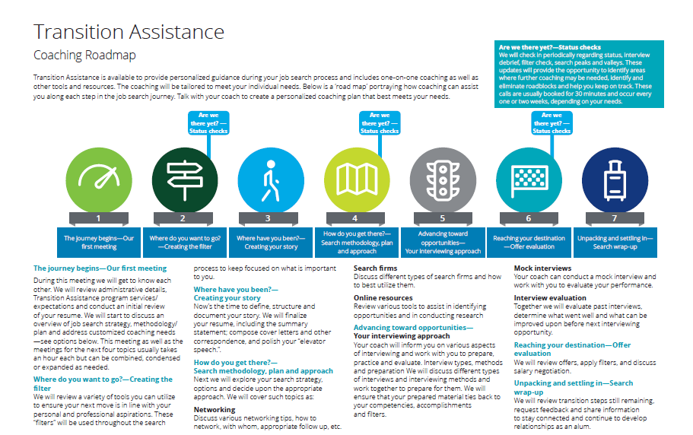
TA roadmap to career transition

Slide 5
Transition Assistance services and resources
Individual, customized coaching
Career planning assistance and self assessment review Overall job search strategy development Resume review and feedback on personal marketing materials Effective networking strategies Interview tips and mock interview practice Offer evaluation and salary negotiation best practices Additional services Live networking calls —exchange job search strategy ideas, tips and contacts with fellow Deloitte alumni in transition “Career transition strategies” —e-brief providing information and tips relative to a job search
Critical transition resources
24/7 Access to online job resources—Variety of online resources, available to supplement the 1:1 coaching, including: Tips and Tools: Access our online “roadmap” with valuable guidance, resources and tools to support you in your job search journey. Visit http://transitionassistance.deloitte.com to access LinkedIn Network: Join the official Deloitte US group on LinkedIn to stay connected with current Deloitte practitioners and alumni and to identify alumni at target employers Job Leads: View job opportunities at companies interested in hiring Deloitte alumni. Visit the jobs dashboard to view the leads and apply directly: https://talent.secure.force.com/jobs/jobsearch
Notes:
5

Slide 6
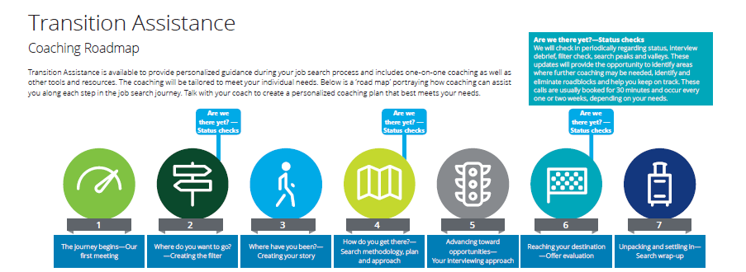
Interactive roadmap—a journey begins http://transitionassistance.deloitte.com

Slide 7
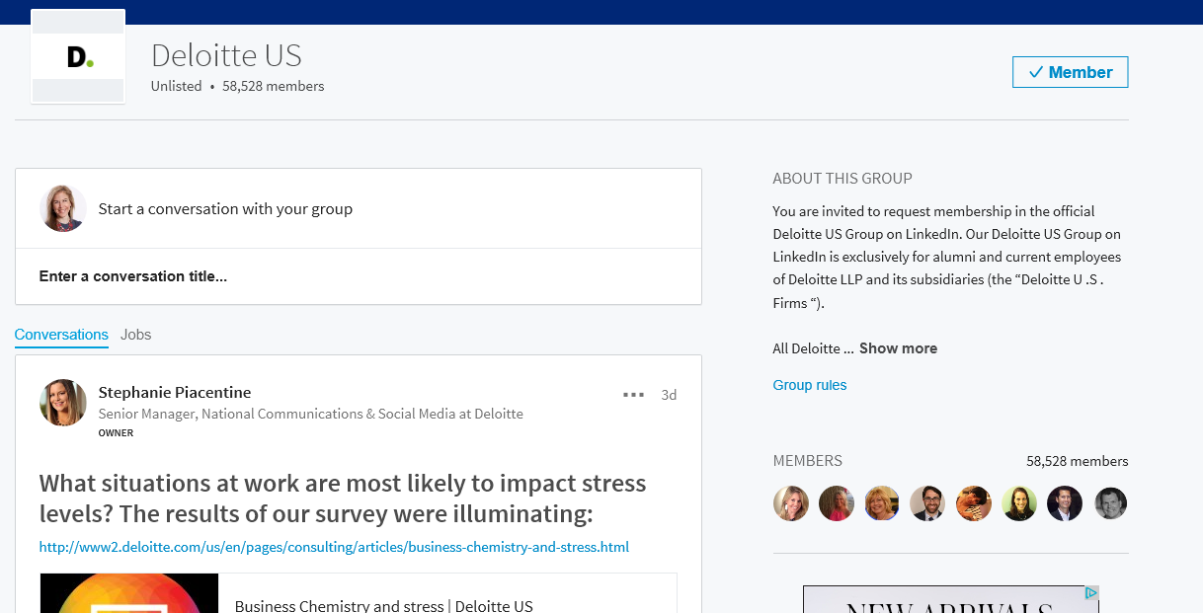
Official LinkedIn Group – Deloitte US Join to Network - https://www.linkedin.com/groups/3727918

Slide 8
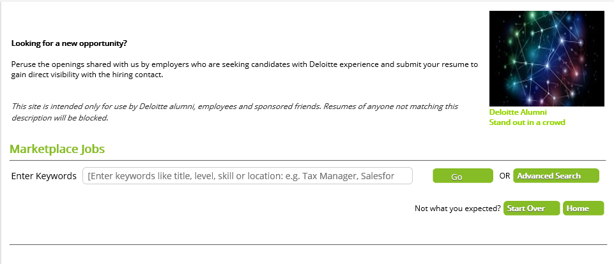
Marketplace jobs—a valuable 24/7 job search resource https://talent.secure.force.com/jobs/jobsearch

Slide 9
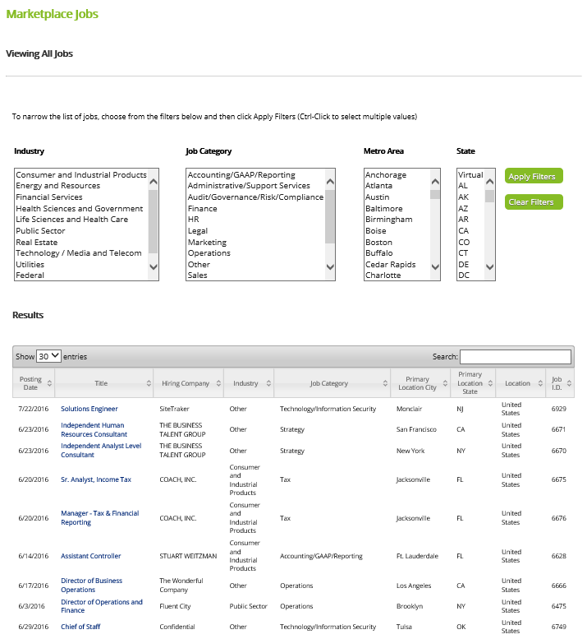
Deloitte Sponsored Job board

Slide 10
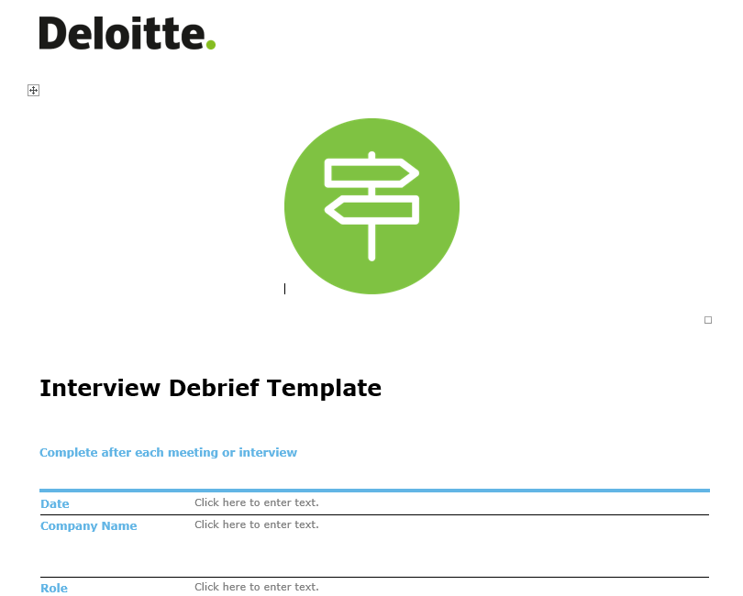
Downloadable tools

Slide 11
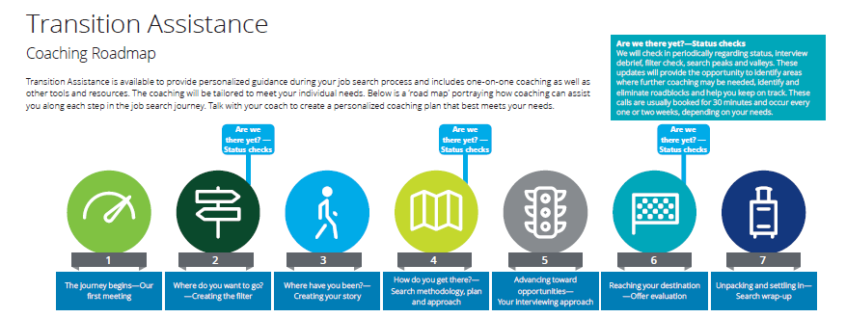
Career Assessments – where do you want to go?
Myers Briggs Type Indicator (MBTI), StrengthsFinder, StandOut

Slide 12
Accessing transition assistance resources
How do I request a coach?
Contact us at transitionassistance@deloitte.com
How long is transition assistance available to me?
The earlier of up to one calendar year or until you find new employment
How do I access transition assistance content online?
All of our job search guidance and tools and recorded webinars can be found at http://transitionassistance.deloitte.com
Where can I find external job postings?
Access external generated job leads at Marketplace Jobs: https://talent.secure.force.com/jobs/jobsearch

Slide 13
The journey begins
Getting started

Slide 14
Managing your emotions
Preparing for your search: Job search is more like a marathon than a sprint.
Managing your emotions: Before you even begin to think about your search, you may find yourself dealing with strong feelings about your current situation. Job loss can evoke a range of emotions from anger to relief to shame. With time, these emotions will slowly be replaced with acceptance, which allows for constructive progress to take place and positive energy and momentum begins to build.

Slide 15
The roadmap to your job search Step 1: The journey begins…
Noted psychiatrist Elisabeth Kubler-Ross describes the five stages of grieving..
They are:
Denial– “This isn’t really happening. I can still go on enjoying life doing all the things I usually do."
Anger– “I can’t believe this. It’s their fault I ‘m in this situation and it makes me so mad. They are a bunch of fools and they don’t know what they are doing.”
Bargaining– “Maybe I can get my job back if I offer go part-time or tell them I am willing to take a pay cut.”
Depression– “There is nothing I can do. There are no jobs out there. Why should I even bother trying to find something?”
Acceptance– “Ok! It is what it is. Time to start exploring and seeing what’s out there!”

Slide 16
The roadmap to your job search Step 1: The journey begins… (cont.)
First things first: Get organized
Talk to your coach, review your resources
Set expectations for the coaching relationship
Set a timeline
When do you ideally want to start a new job
When can you realistically start a new job
When does “plan b” kick in
Set a daily schedule
When you will search the boards
When you will make calls
When you will exercise/relax
How will you balance your transition of responsibilities
Develop your plan
Download the job search checklist

Slide 17
Where do you want to go?
Creating the filter

Slide 18
The roadmap to your job search Step 2: Where do you want to go?
A variety of assessments, and tools – ‘filters’ available. Discuss options with your coach:
Formal assessments (Myers-Briggs, StrengthsFinder, StandOut)
Complete our likes/dislikes matrix or simply create 3 lists to document the things you:
like to do
are good at
don’t like to do
Identify your career values
Define short and long term personal and professional goals
Life’s Purpose and Passion Exercise

Slide 19
Next steps

Slide 20
Next steps for you…
Request a coach
Send an email to: transitionassistance@deloitte.com
Visit http://transitionassistance.deloitte.com
Online guidance and tools
Recorded job search webinars
Attend Tuesday virtual networking call
12pmCST/1pmEST/10amPST

Slide 21
About Deloitte Deloitte refers to one or more of Deloitte Touche Tohmatsu Limited, a UK private company limited by guarantee (“DTTL”), its network of member firms, and their related entities. DTTL and each of its member firms are legally separate and independent entities. DTTL (also referred to as “Deloitte Global”) does not provide services to clients. Please see www.deloitte.com/about for a detailed description of DTTL and its member firms. Please see www.deloitte.com/us/about for a detailed description of the legal structure of Deloitte LLP and its subsidiaries. Certain services may not be available to attest clients under the rules and regulations of public accounting. Copyright © 2016 Deloitte Development LLC. All rights reserved. 36 USC 220506

