Slide 1

Offer Review & Salary Negotiations
A career development webinar for Deloitte Transition Assistance
Notes:
Hello, and welcome to our Deloitte alumni webinar on Offer Review & Salary Negotiations. I’m Mark Zoeller, and am joined by my colleague, JoAnne Fink. We are Transition Assistance coaches, and we’re happy to share with you today some tips and techniques related to reviewing and potentially negotiating offers.

Slide 2
Agenda
Topic | Content
Planning and Preparation for Salary Discussions | Competitive Market Value
Evaluating Offers | Key things to keep in mind Handling Multiple Offers
Negotiating the Salary/Offer | Key Strategies Declining Offers

Slide 3
Planning and Preparation for Salary Discussions

Slide 4
-Three Key Steps:
Planning for Salary Discussions
      Understand your competitive market value
      Determine your minimum salary requirements
      Determine your ideal salary range

Slide 5
Planning for Salary Discussions
Role-play Demonstration

Slide 6
Evaluating Offers

Slide 7
Evaluating Offers
Consider the entire compensation package – not just salary.
Insurance (Medical/Dental/Vision/Life)
401(k) plans
Vacation days/Sick leave/PTO
Pension/Profit Sharing plans
Stock options/ESOPs
Employee assistance program
Tuition reimbursement
Company vehicle or car allowance
Relocation expenses
Flexible work arrangements

Slide 8



Evaluating Offers (cont.)
Potential questions to consider:
Do you like the work?
Are you able to transfer skills and experience from previous jobs to contribute to your success in the new organization?
Are the responsibilities likely to provide you with a challenge?
Is the opportunity for growth and advancement compatible with your needs and desires?
Will the company provide support for your professional development, including support for continuing education, training, and mentoring?
Are the company’s location, stability and reputation in line with your needs?
Is the stability and growth potential of the industry in line with your needs?
Is the culture of the company conducive to your enjoying working there?
Is the senior leadership of the organization a reputable and high-quality group?
Will the position provide you with a lifestyle, including work hours and travel requirements, that is suitable for you and your family?

Slide 9
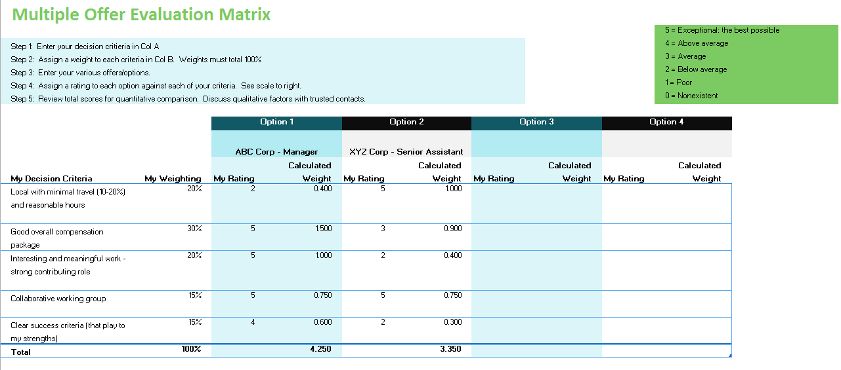
Evaluating Offers (cont.)
How to deal with multiple offers:

Slide 10
Negotiating the Salary/Offer

Slide 11
Negotiating the Offer
  Prepare thoroughly and do your research.
Understand various timing considerations.
Negotiate to your strength. Illustrate your added value to the company.
Consider creative alternatives/options.
Be positive and productive.
Be prepared for a variety of responses from hiring company.
Know when to walk away or when to concede. Or not negotiate at all.
Confirm offer in writing.

Slide 12
Negotiating the Salary/Offer
Role-play Demonstration

Slide 13
Declining Offers

Slide 14
Declining an Offer
Be Prompt
Be Courteous
Be Diplomatic
Be Concise

Slide 15

Other job search webinars to assist you in your search
Getting Started – The Journey Begins!
Resume Workshop – It's all about you!
Get Connected – How Effective Networking Can Bring Value to your Job Search
Interview Skills & Practice
The Connected Job Search: Online and Social Media Strategy

Slide 16

About Deloitte
Deloitte refers to one or more of Deloitte Touche Tohmatsu Limited, a UK private company limited by guarantee (“DTTL”), its network of member firms, and their related entities. DTTL and each of its member firms are legally separate and independent entities. DTTL (also referred to as “Deloitte Global”) does not provide services to clients. In the United States, Deloitte refers to one or more of the US member firms of DTTL, their related entities that operate using the “Deloitte” name in the United States and their respective affiliates. Certain services may not be available to attest clients under the rules and regulations of public accounting. Please see www.deloitte.com/about to learn more about our global network of member firms.
This publication contains general information only, and Deloitte is not, by means of this publication, rendering accounting, business, financial, investment, legal, tax, career counseling, recruiting, or other professional advice or services. Deloitte shall not be responsible for any loss sustained by any person who relies on this publication. Deloitte does not screen resumes, advocate, or negotiate on your behalf or on behalf of any other hiring party.
Copyright © 2018 Deloitte Development LLC. All rights reserved.
36 USC 220506

